Slide 1
Design and Analysis of Algorithm
UNIT-III
Dynamic Programming
M Yogi Reddy
Assistant Professor,
Dept. of CSE,
School Of Technology,
GITAM(Deemed to be ) University,
Hyderabad.

Slide 2

Contents
General Concept
1
Dynamic vs Divide and conquer
0-1 Knapsack Problem
2
3

Slide 3
Dynamic Programming
Definition
Dynamic Programming is an algorithm design technique for optimization problems: often minimizing or maximizing.
Like divide and conquer, Dynamic Programming solves problems by combining solutions to sub-problems.
Unlike divide and conquer, sub-problems are not independent.

Slide 4
Dynamic Programming
The term Dynamic Programming comes from Control Theory, not computer science. Programming refers to the use of tables (arrays) to construct a solution.
In dynamic programming we usually reduce time by increasing the amount of space
The table is then used for finding the optimal solution to larger problems.
Time is saved since each sub-problem is solved only once.
Dynamic Programming is mainly used when solutions of same sub-problems are needed again and again.

Slide 5
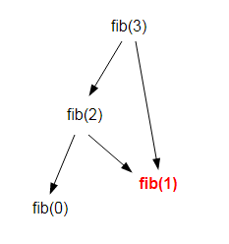
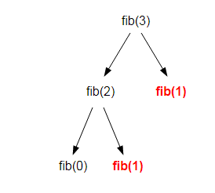
Divide and Conquer Vs Dynamic
Divide and Conquer approach
Dynamic Programming approach
fib(n)
{
if ( n <= 1 )
return n;
return fib(n-1) + fib(n-2);
}

Slide 6



Divide and Conquer Vs Dynamic
Divide and Conquer approach
Dynamic Programming approach
Fibonacci Series
{
if ( n <= 1 )
return n;
return fib(n-1) + fib(n-2);
}
Fib(n)
{ mem[0] = 0
mem[1] = 1
for i = 2...n
mem[i] = mem[i-2] + mem[i-1]
return mem[n]
}
Finding factorial of $n≥ 1$
$for i=1:n\{$
$$f(i)=i∗f(i−1)$$
$\}$
$$f\left(n\right)=n×f(n−1)$$

Slide 7
Difference between Greedy and Dynamic Algorithm
Greedy Method:
Some times give wrong answer
Takes less time
One decision at a time
Dynamic Method:
Always give correct answer
Takes more time
Sequence of decisions

Slide 8
Elaborate Dynamic Programing
0-1 Knapsack
Greedy Algorithm will not give optimal solution for 0-1 knapsack problem, So we use dynamic programming which will cover all possible combination.
Algorithm:
K(n, W)
{
if(n==0 or W==0)
{ Return 0; }
else if (wn > W)
{ K(n-1,W) }
else
{ a = K(n-1, W- wn) + Pn ;
b = K(n-1, W)
Return Max(a, b);
}
}
Where W is capacity of knapsack
n is no of objects
wn is weight of each object
Pn is profit of each object

Slide 9
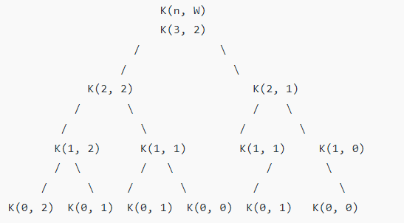
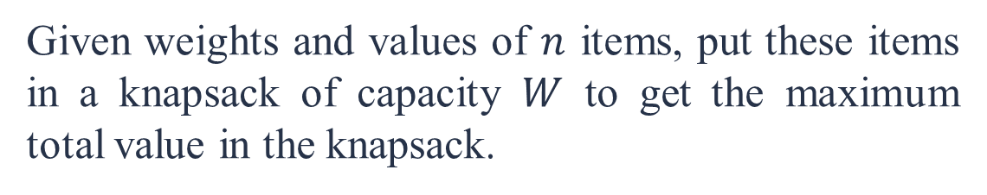
0-1 Knapsack
Given weights and values of $n$ items, put these items in a knapsack of capacity $W$ to get the maximum total value in the knapsack.
Given that n = 3 W = 2
Now, We are following Recursive tree
Objects | 1 | 2 | 3
Profits(Pn) | 10 | 20 | 30
Weights (wn) | 1 | 1 | 1

Slide 10
Complexity Analysis
It should be noted that the above function computes the same sub-problems again and again. See the following recursion tree, K(1, 1) is being evaluated twice.
The time complexity of this naive recursive solution is exponential (2^n).

Slide 11



